Slide 1
Data in the Cloud – I
Parallel Databases
The Google File System
Parallel File Systems

Slide 2
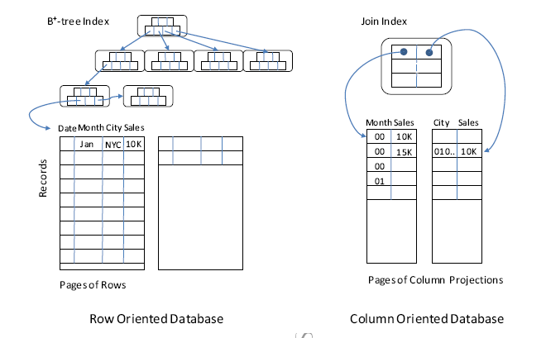
Relational Database Technology
Row-stores are good for transactional workloads with many random reads and updates, and strong concurrency control requirements
Column-stores are good for data-warehouse workloads, with batch data insert/append followed by many aggregation queries: SELECT …. SUM() … GROUP BY …

Slide 3
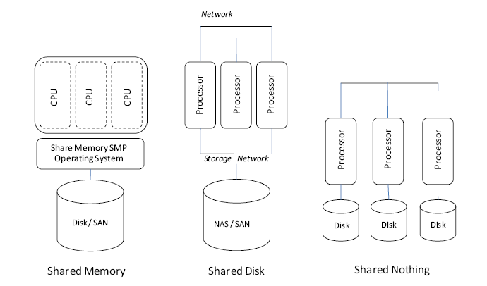
Parallel Databases
Automatic parallelization of SQL queries
Distributed `two-phase commit’ locking for transaction isolation
Partitioning tables across disks (by rows or columns as appropriate)
Typical parallel databases run with at most few dozens of servers

Slide 4
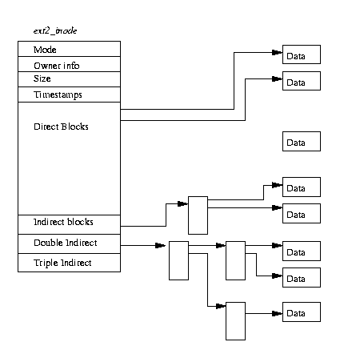
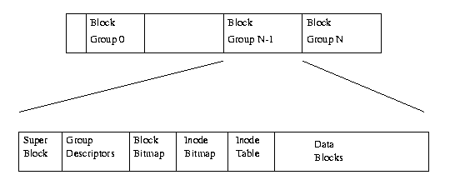
File Systems
File systems traditionally designed for random access by a single process
Parallelism managed by client application, e.g., parallel databases
Fault-tolerance limited to replication of block descriptions, not data itself

Slide 5
Google File System
Motivation:
Large-scale distributed storage of massive files
Fault-tolerance a necessity, since
p(system failure) = 1-(1-p(component failure))^{N} 1 for large N
Ensuring parallel block reads as well as parallel bulk appends:
such as being able to read indexes that are continuously being updated
High-volume reads and bulk appends
Acceptable level of consistency
Acceptable level of latency for random writes
Not included:
Parallel I/O (any parallelism is handled by the application)
High-volume random writes

Slide 6
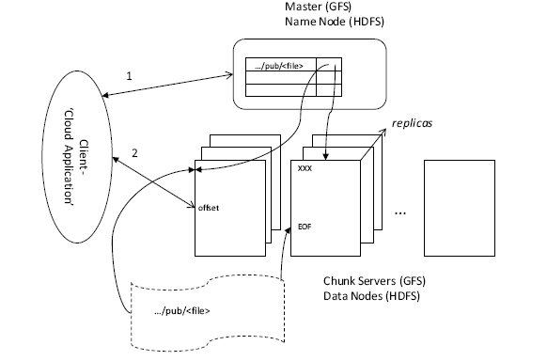
GFS Architecture
Single master controls file namespace
Data broken in 64Meg “Chunks”
Chunks replicated over many “Chunk Servers”
Client talks directly to chunk servers for data
Read:
Send full path and offset to Master; receive meta-data for chunk-server of one replica
Client directly connects to chunk-server to read data
GFS does not cache data – any caching is as provided by local client / chunk-server OS

Slide 7
GFS Architecture (cont.)
Record-append (no offset specified): (e.g. record = document, index-block, etc.)
Send full path to Master; receive meta-data for chunk-server of all replicas
Client sends data to be appended to chunk-server of each replica; waits for acknowledgement
Once all replicas have replied, client informs chunk-server of primary replica
Primary chunk-server then chooses the offset where to append the data (may be beyond EOF in case many clients are appending to the same file); sends offset to each replica
If all replicas do not succeed in writing at the designated offset, the primary retries
(some replicas can have duplicate/junk data interleaved with ‘defined’ data)

Slide 8
Consistency in GFS
Consistent:
All chunk servers have the same data
Defined:
The result of the “last write operation” (such as a record-append) is available in its entirety
A defined chunk is also a consistent chunk
Questions:
Is data corrupt if it is inconsistent?
Is data corrupt if it is undefined?
Can applications use data in either state?
How?
n
n
m
m
Consistent
n+1
n+1
n+2
n+2
m+1
m+1
n+3
n+3
inconsistent
padding
n
padding
n+1
m
m
Defined
m+1
m+1
n
n
n+1
n+1
n+2
n+2
n+3
n+3
Concurrent writers on a standard file system will yield consistent but undefined data
GFS data consists of defined segments interleaved with inconsistent ones

Slide 9
Parallel File Systems
In GFS, the I/O bandwidth from one client to a particular file remains the same as for a normal networked file system
Parallel file systems distribute (stripe) blocks of a file across many storage servers similar to RAID disks
High-bandwidth parallel I/O
Lustre:
Blocks of file are striped across objects
Objects are distributed across many parallel object stores
Applications:
Scientific computing
Video recording and analysis

